Slide 1
The Human Eye
Structure and its function

Slide 2
The Human Eye
The human eye is a sensory organ that reacts to light and allows vision, light perception, color differentiation and the perception of depth.
The human eye can be compared to a camera which gathers, focuses, and transmits light through a lens to create an image of the environment.

Slide 3
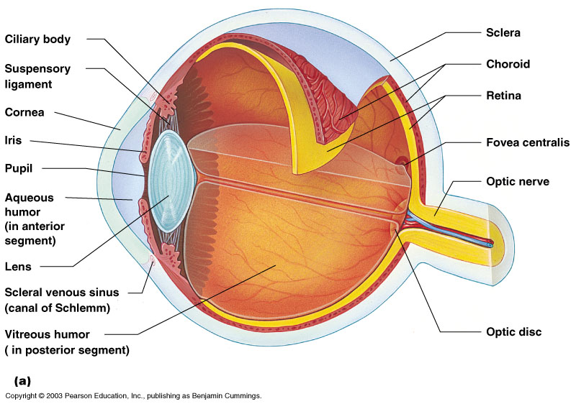
Structure of Eye
Sclera:
The outer coat of the eyeball that forms the visible white of the eye and surrounds the optic nerve at the back of the eyeball.

Slide 4
Structure of Eye
Choroid:
Layer of blood vessels located between the sclera and the retina
They provide nourishment to the back area of the eye

Slide 5
Structure of Eye
Retina:
The sensory membrane that lines the eye
It receives images formed by the lens and converts them into signals that reach the brain by the way of optic nerve

Slide 6
Structure of Eye
Cornea:
The clear part of the eye covering the iris and the pupil
It lets light into the eye permitting sight.

Slide 7
Structure of Eye
Iris:
Colored part of the eye surrounding the pupil
The pigmented membrane lies between the cornea and the lens
It acts as a diaphragm to narrow or widen the opening called the pupil, thereby controlling the amount of light that enters the eye.

Slide 8
Structure of Eye
Pupil:
The round dark center of the eye
It opens and closes to regulate the amount of light that retina receives

Slide 9
Structure of Eye
Aqueous Humor:
Clear fluid in the front of the eye between the cornea and the iris, that provides nutrients to the cornea and the lens.
The fluid is produced by the ciliary body.

Slide 10
Structure of Eye
Conjunctiva:
Mucous membrane that lines the visible part of the eye and inner side of the eyelids

Slide 11
Structure of Eye
Suspensory ligaments (Zonules):
Membrane of fibers that holds the eye’s lens in place.

Slide 12
Structure of Eye
Ciliary Body:
Part of the eye between the choroid and the iris.
The functions of ciliary body includes accommodation, production of aqueous humor and holding the lens in place.

Slide 13
Structure of Eye
Anterior chamber:
Part of the eye behind the cornea and in front of the iris and the lens.

Slide 14
Structure of Eye
Posterior chamber:
Part of the eye behind the iris and in front of the lens.

Slide 15
Structure of Eye
Lens:
The nearly spherical body in the eye, located behind the cornea, that focuses the light rays onto the retina.

Slide 16
Structure of Eye
Macula lutea (Fovea):
Part of the eye near the middle of the retina.
It contains cluster of cones, responsible for sharp, detailed and colored vision.

Slide 17
Structure of Eye
Optic Nerve:
The nerve that carries electrical impulses from the photoreceptor cells (rods and cones) in the retina to the visual cortex in the brain.

Slide 18
Structure of Eye
Optic Disc (Optic Nerve Head):
Circular area where the optic nerve enters the retina and the location of the eye’s blind spot.

Slide 19
Structure of Eye
Vitreous Humor:
Clear jelly present in the vitreous body in between the lens and the retina of the eye.

Slide 20
How the Human Eye Works
Light is focused primarily by the cornea — the clear front surface of the eye, which acts like a camera lens.
The iris of the eye functions like the diaphragm of a camera, controlling the amount of light reaching the back of the eye by automatically adjusting the size of the pupil (aperture).

Slide 21
How the Human Eye Works
The eye's crystalline lens is located directly behind the pupil and further focuses light. Through a process called accommodation, this lens helps the eye automatically focus on near and approaching objects, like an autofocus camera lens.
Light focused by the cornea and crystalline lens (and limited by the iris and pupil) then reaches the retina — the light-sensitive inner lining of the back of the eye. The retina acts like an electronic image sensor of a digital camera, converting optical images into electronic signals. The optic nerve then transmits these signals to the visual cortex — the part of the brain that controls our sense of sight.

Slide 22
How the Human Eye Works

Slide 23
Vision Defects
Myopia:
Nearsightedness, a person can see nearby objects clearly while distant objects appear blur
Image is formed in front the retina
Causes:
Excessive curvature of the cornea
Elongation of the eye lens
Correction:
The defect can be corrected using a concave (diverge) lens

Slide 24
Vision Defects
Hypermetropia:
Farsightedness, a person is able to see distant objects clearly
The image is formed behind the retina
Causes:
The focal length of the lens is too great
The eyeball becomes too short
Correction:
The defect can be corrected using convex (converging) lens

Slide 25
Vision Defects
Presbyopia:
Progressive form of farsightedness
Affects most people by their early 60s.

Slide 26
Thank You ☺

